Slide 1
Checkpoint 2 & 3
Yichen Sheng

Slide 2
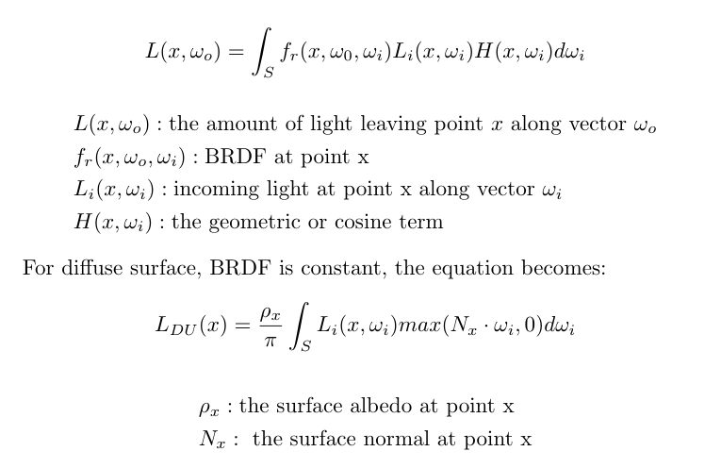
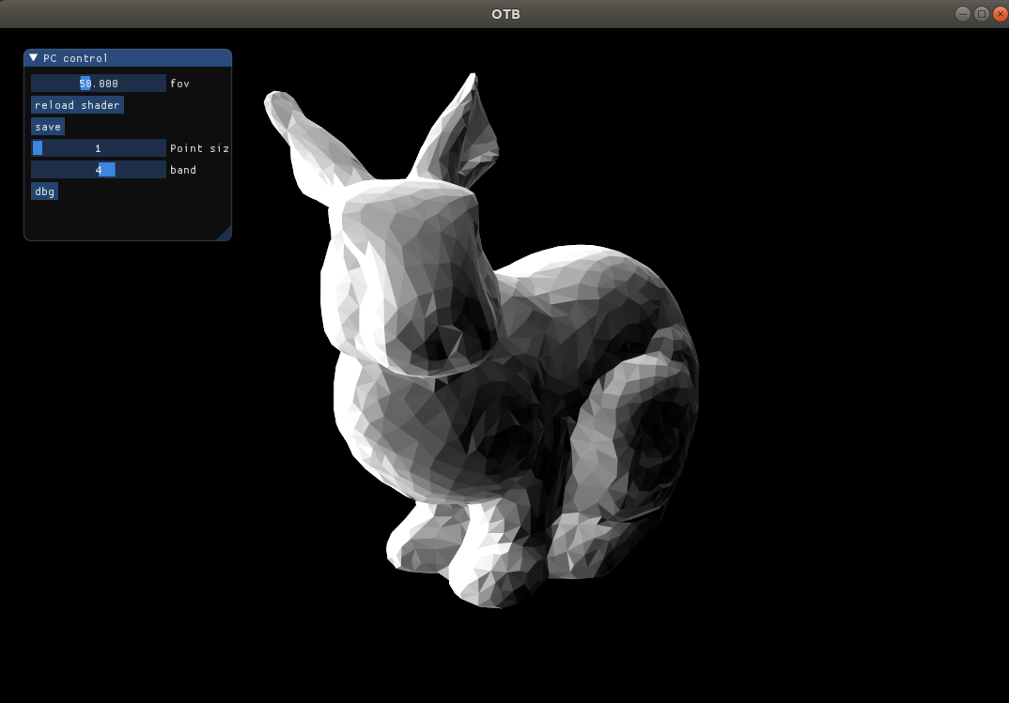
Diffuse (unshadowed) SH rendering (4 bands)

Slide 3
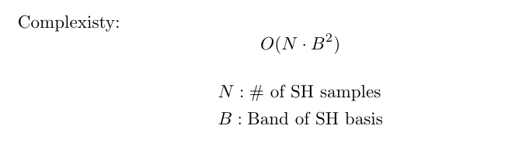
Diffuse (unshadowed) SH rendering (4 bands)
For each vertex:

Slide 4
Exp on bands (1~12)

Slide 5
Diffuse (unshadowed) SH rendering

Slide 6
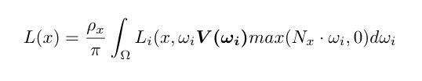
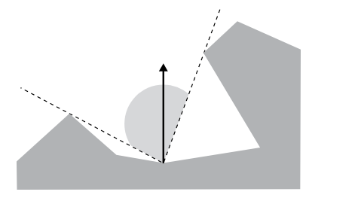
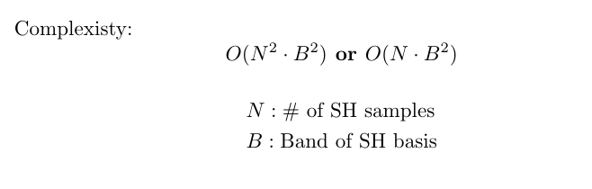
Diffuse (shadowed) SH rendering

Slide 7
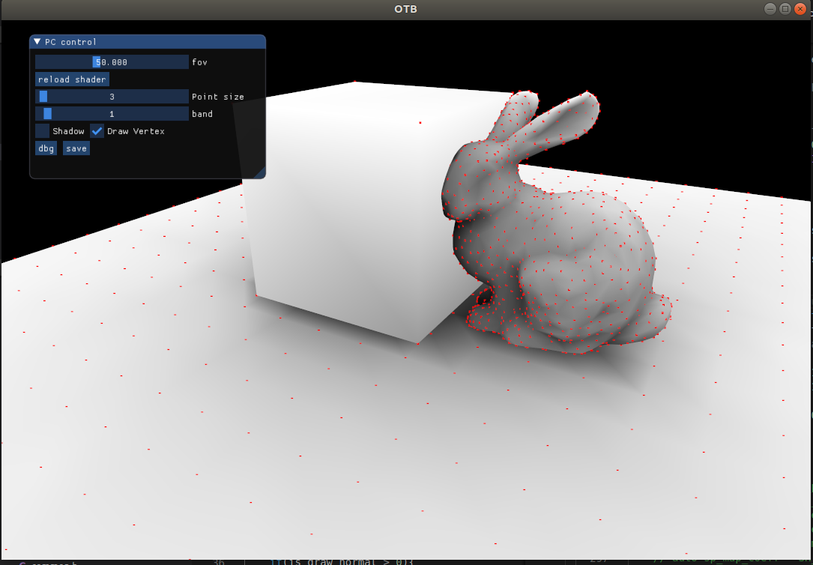
Visibility

Slide 8
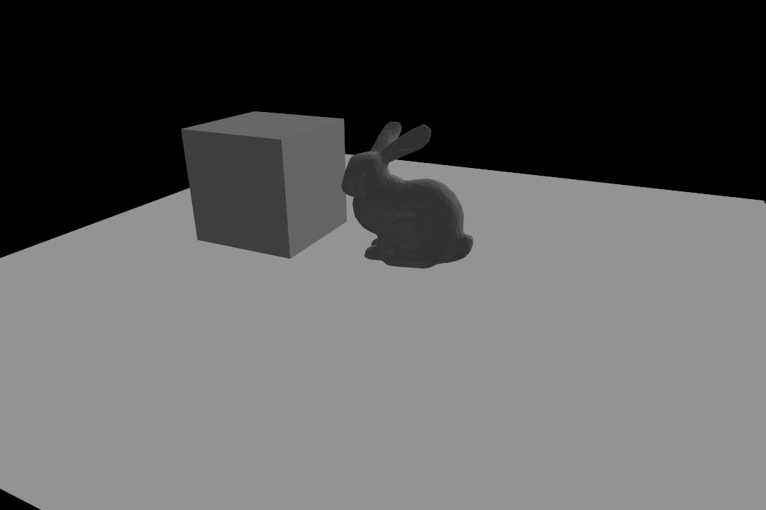
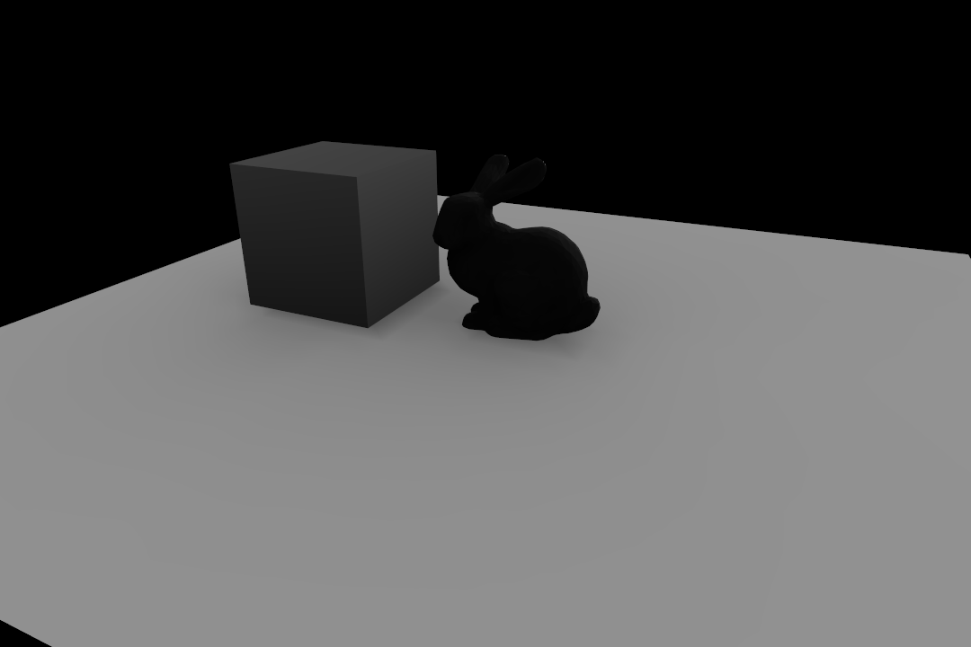
Diffuse(shadowed) SH rendering

Slide 9
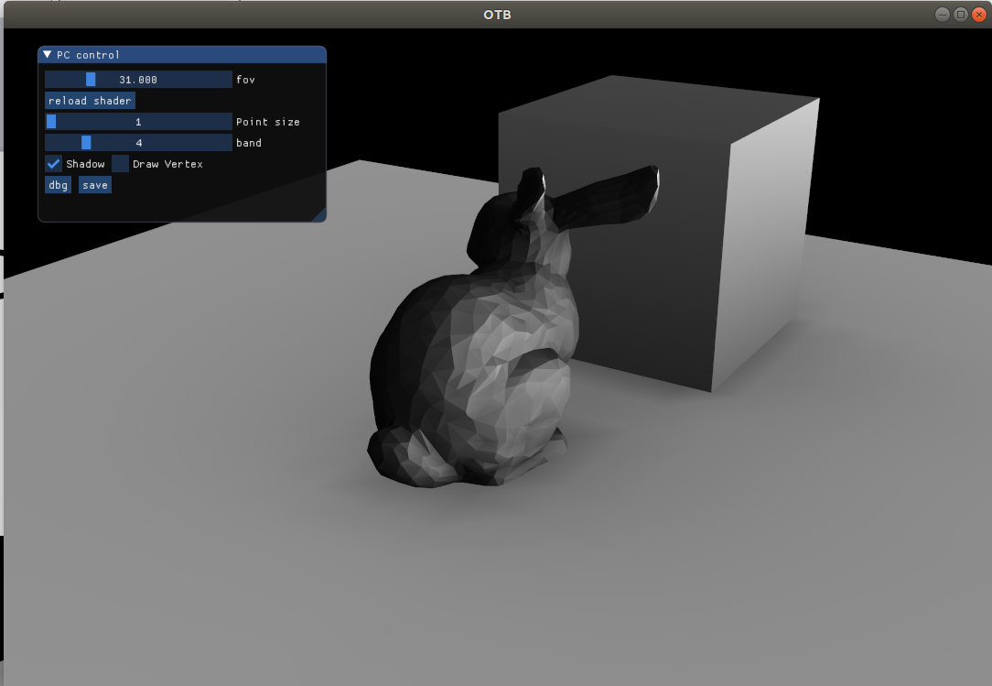
Diffuse(shadowed) SH rendering

